Slide 1
ConversAI: The Intelligent SQL Agent
-Meera Reji

Slide 2
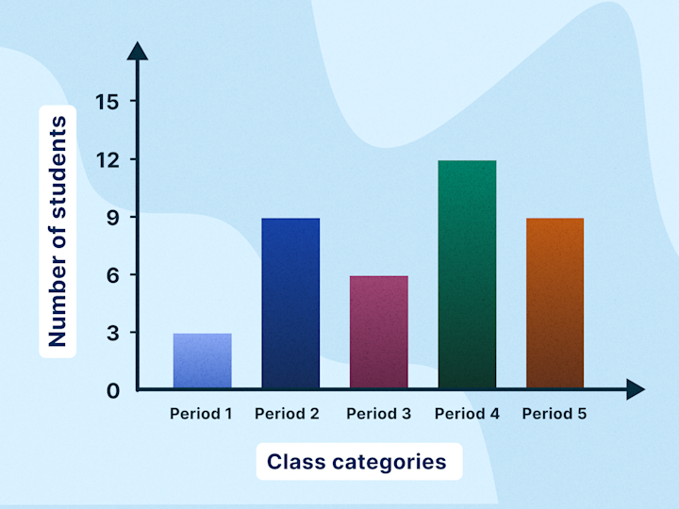
ConversAI: The Intelligent SQL Agent
Introduction
ConversAI: The SQL Intelligence Agent
Interact with e-commerce data using natural language
Multi-Agent System:
SQL Agent: Converts user questions into SQL queries
RAG Retriever: Performs semantic search using ChromaDB
Visualization Generator: Displays results as tables and charts
Web Browser Agent: Browses the web to fetch external product/industry information and definitions
Voice Query Support: Supports voice-based queries for accessibility.

Slide 3
ConversAI: The Intelligent SQL Agent
Architecture

Slide 4
ConversAI: The Intelligent SQL Agent
Stage 1:Data Storage & Vectorization Pipeline
Steps Implemented
Google Drive Integration: Mounted Drive to store databases and vector data persistently.
Data Ingestion & Storage: Loaded CSV files and stored them as tables in SQLite (olist_sqlite.db).
Vector Store Setup: Created a persistent ChromaDB for long-term text embedding retrieval.
Embedding Model: Used BAAI/bge-m3 (Transformer-based) for multilingual text embeddings.
Vectorization: Converted text fields into dense vectors and stored them with metadata in ChromaDB.

Slide 5
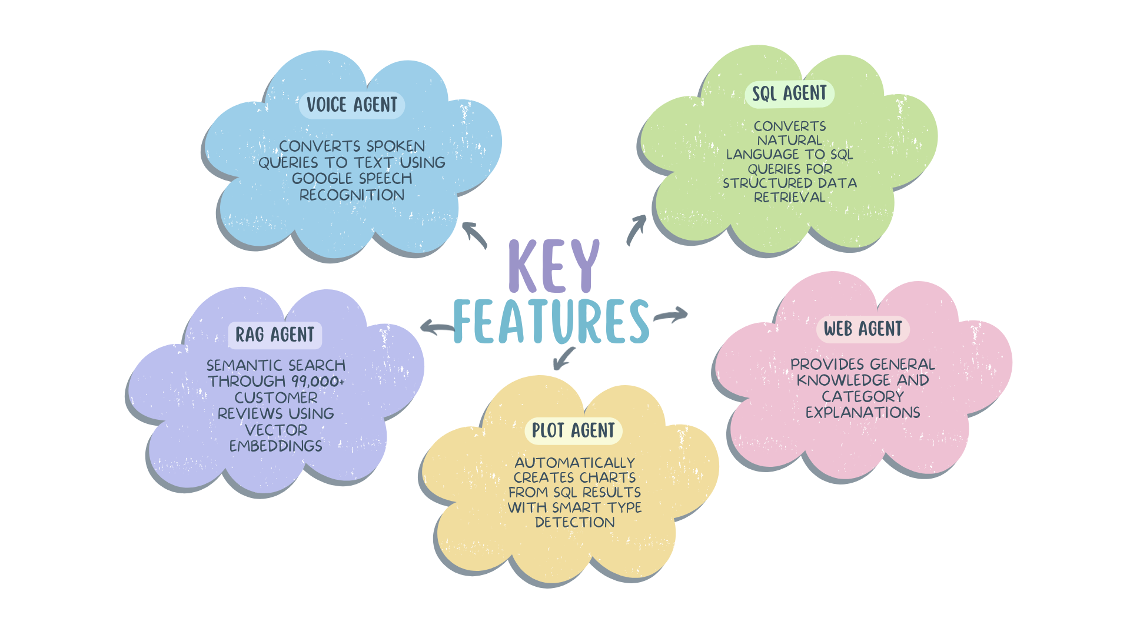
ConversAI: The Intelligent SQL Agent
Stage 2:Agents

Slide 6

ConversAI: The Intelligent SQL Agent
Demo
DriveLink: https://drive.google.com/file/d/1GFHXOU07knUGFXMOksIJG40CEA4jg6uk/view?usp=sharing
YouTube Link: https://youtu.be/ffmUvqMdlZc

Slide 7
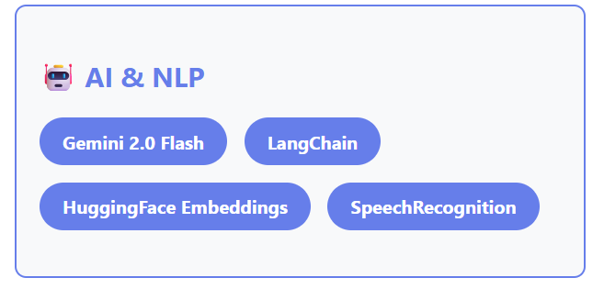
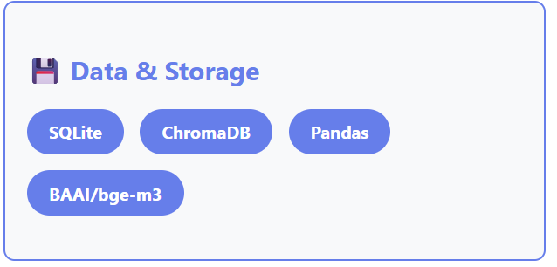
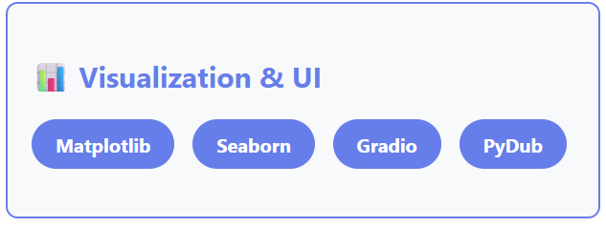
ConversAI: The Intelligent SQL Agent
Tech Stack

Slide 8
ConversAI: The Intelligent SQL Agent
Future Enhancements
Multi-language support – Transcribe and query in Portuguese, Spanish, and other languages.
Query suggestions – Autocomplete based on recent queries for faster interaction.
Predictive analytics – Forecast sales trends and identify trending products.
Real-time data streaming – Stream live orders instead of relying on historical data.
Fine-tuned models – Domain-specific SQL generation using LoRA fine-tuning for higher accuracy.
Improved context handling – Smarter follow-up query interpretation and caching.

Slide 9
ConversAI: The Intelligent SQL Agent
Github
Link to the github repo:
https://github.com/MeeraReji/ConversAI-SQL-Agent

Slide 10
Thank You

